Slide 1
The first 50 nodes: The DevOps-ish journey at a Windows Enterprise
Notes:
Hi I’m Scott Nasello. I’m going to discuss some of our journey today.
I can tell what you are thinking…Haven’t I heard some version of this talk before?
It’s very likely you have, so let me tell you why I’m here
Our community is built on sharing…we have received our fair share of help and so we need to give back
I’d like to role-model behaviors I’m asking my team to demonstrate
Windows scenarios are much less represented

Slide 2

Change advice from an 6 year old
“Get messy and make mistakes” – Lucca Nasello
Notes:
My son is wise beyond his years…
I highly recommend Little One Step…big things can be achieved through a series of small steps

Slide 3
About us
99.5% VMware, 99.9% Microsoft Server (3000+ Servers)
Largely 3 tier COTS business applications
Notes:
We’re a On-premises Windows shop with a ton of 3rd party business applications…
Our typical engineer has 15+ years of industry experience and 5+ years at Columbia

Slide 4

Enter Gene Kim
Phoenix Project !
*Gene Kim: Why You Need DevOps Now: A Fourteen Year Study...
Notes:
My Boss couldn’t attend one of the SIM PDX meetings and suggested that I might like to go…
I didn’t know what was on the agenda and didn’t know much about Gene Kim or DevOps
After his 3 ways presentation I felt inspired (and obligated)

Slide 5
Top 5 Predictors of IT Performance*
Peer-reviewed change approval process
Version control for all production artifacts
Proactive monitoring
High-trust organization culture
Win-win relationship between dev and ops
*Puppet Labs State of the DevOps
Notes:
Understanding your organization and the ability to absorb change, we focused on getting artifacts into version control
Version control was used as a gateway activity to introduce other ideas
During 2015 we went from Zero to 500 artifacts in version control

Slide 6

Click, Click, Next jobs are obsolete*
*Jeffrey Snover – Arrested DevOps Episode 30 - DevOps in a Microsoft World
Notes:
This single video was one of the most powerful tools in the toolbox.
Jeffrey does a wonderful job sharing “Tough Love” that should resonate with IT Pros (Windows Engineers)
“I thought I might be done with learning”
“If you don’t want change, you should get into forestry”
7:53 -

Slide 7
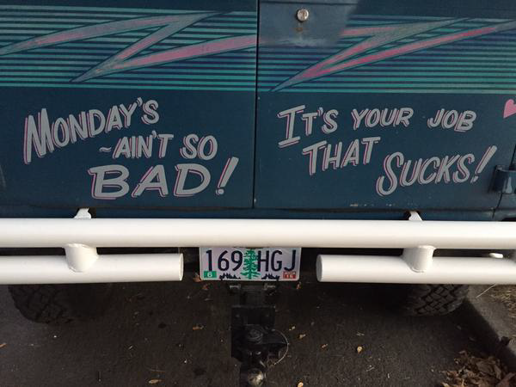
Click, Click, Next jobs are obsolete*
+
*Jeffrey Snover – Arrested DevOps Episode 30 - DevOps in a Microsoft World
Notes:
Empathy
Applying the messages from Jeffrey, we can have a whole different discussion with our long tenured Windows Professional…
Given that you agree your job (in it’s current form) isn’t going to keep you growing, how can I help you to grow?
As a leader, how can you simultaneously benefit the business (less fragile) and IT Pros → The Win Win

Slide 8

Click, Click, Next jobs are obsolete*
+
=
*Jeffrey Snover – Arrested DevOps Episode 30 - DevOps in a Microsoft World
Notes:
Empathy
Applying the messages from Jeffrey, we can have a whole different discussion with our long tenured Windows Professional…
Given that you agree your job (in it’s current form) isn’t going to keep you growing, how can I help you to grow?
As a leader, how can you simultaneously benefit the business (less fragile) and IT Pros → The Win Win

Slide 9
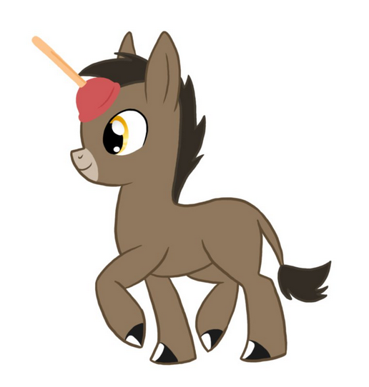
Yeah but…
“We are not like Flickr | Amazon | Netflix | Etsy”
“Why would we even want to deploy _____ servers in a day?”
“Wait, what? They have a SSH/RDP tip jar?”
“We don’t need______I can already do all that with Windows…”
“We don’t have time to make things better… “
Notes:
All of these objections are completely valid and are probably FUD (Fear, Uncertainty, and Doubt) since much of this is not intuitively obvious
Understanding that the term DevOps is loaded, steer the conversation to “what do you have to lose in trying?” …If it stinks, we will gladly try something else

Slide 10
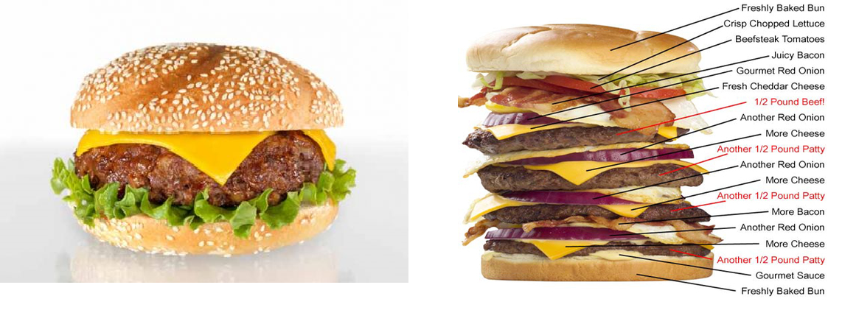
Minimum Viable Process (MVP) *
Tweak practices just before the team becomes comfortable
*Lean Enterprise Humble, Molesky, O’Reilly
Notes:
We used Minimum Viable Product/Process heavily in our journey (more of an continued evolution)
Let the team define the processes they believe will generate the desired outcomes
We picked a couple of folks to run different experiments and then to compare against the larger group

Slide 11



DevOps may not be our destination: Becoming less fragile is central to our journey
Notes:
Tools can be a means to and end

Slide 12

Early Adopters
Notes:
You may already have early adopters at your company…
Who is already a good scripter?
Who’s a little frustrated
Who’s willing to try new things?
Important to be able to articulate the outcomes you are looking for (versus the how)

Slide 13

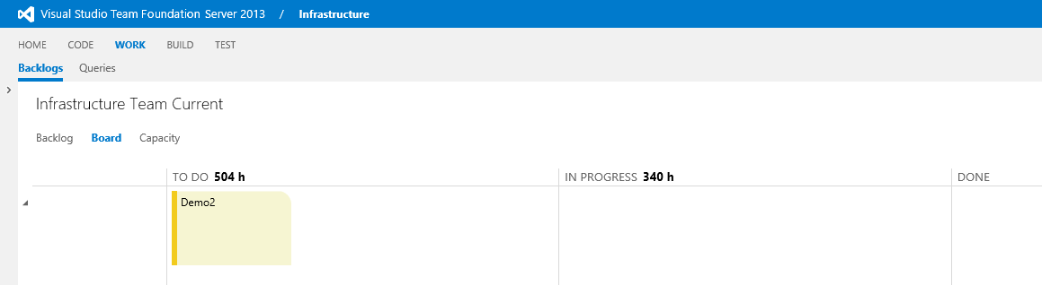
Making the work visible – Kanban*
How have you made it as easy as possible to participate?
* Dominica Degrandis - Kanban Flow meets DevOps
Notes:
Used Microsoft TFS to expose the work on Kanban boards
We run a weekly infrastructure standup with week long sprints…
As your folks how you can make it easier…The PowerShell enhancement was created to reduce friction and context switching
Understand that you will get interruptions at first, so plan some extra buffer
All “work should” be exposed

Slide 14
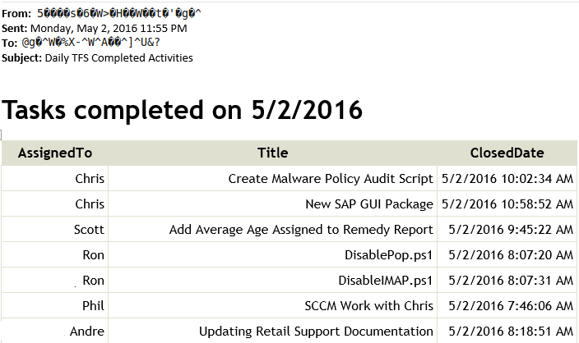
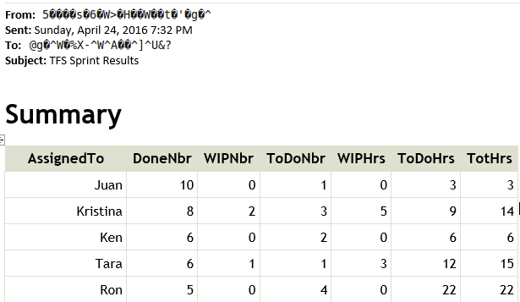
Metrics to reinforce flow
Notes:
These reports are scheduled to run daily/weekly using PowerShell
Gentle pressure, team starts to norm around behaviors
Ideally the team starts to police itself around these practices
If you don’t measure critical activities, how do you know where / when to change things?

Slide 15
Version Control and Scripting and Kanban…Oh My!
Notes:
We had some tough spots where we became a little overwhelmed…
It’s okay for managers and leaders to show vulnerability from time to time (as well as optimism and confidence in the team)

Slide 16
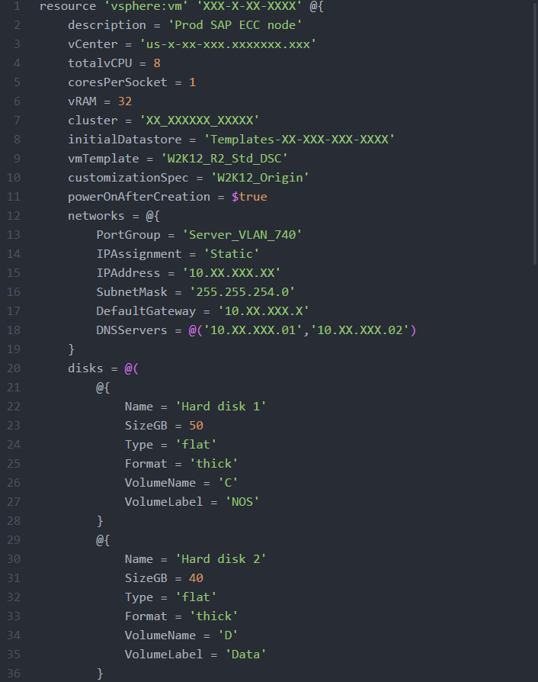
Server script - simple
Notes:
We used PowerCLI & DSC to script bare metal Server provisioning
We’ve enhanced our template (optimized for WYSIWYG & reduced learning curve for Ops & Dev)
This pattern gives you great leverage to scale out
We are well over 250 nodes now, and we are now investigating brownfield applications and servers
We built on success by extending our server automation to a system refresh : 4 environments, 50+ greenfield servers, 3 tier COTS
Dev team worked to automate Tomcat, Ant, Java, Shares, etc.
Ops team worked to harden server automation

Slide 17
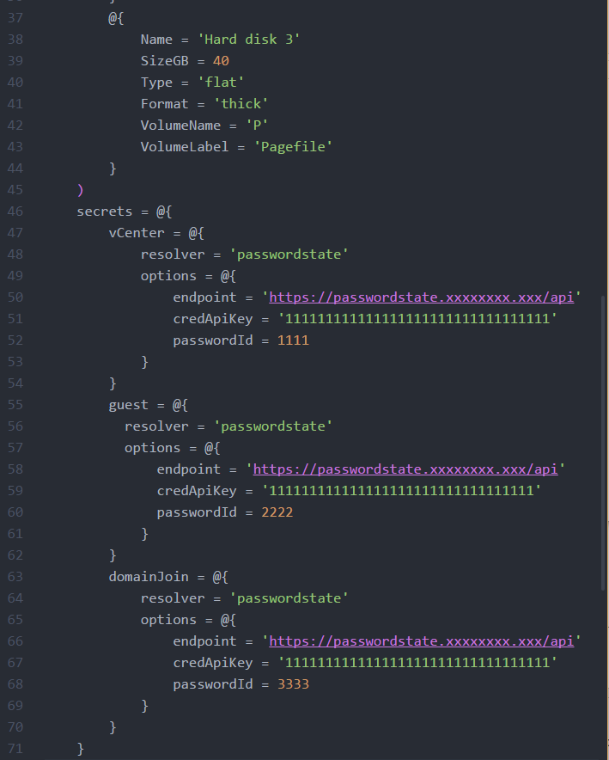
A little harder now…
Notes:
We used PowerCLI & DSC to script bare metal Server provisioning
We’ve enhanced our template (optimized for WYSIWYG & reduced learning curve for Ops & Dev)
This pattern gives you great leverage to scale out
We are well over 250 nodes now, and we are now investigating brownfield applications and servers
We built on success by extending our server automation to a system refresh : 4 environments, 50+ greenfield servers, 3 tier COTS
Dev team worked to automate Tomcat, Ant, Java, Shares, etc.
Ops team worked to harden server automation

Slide 18
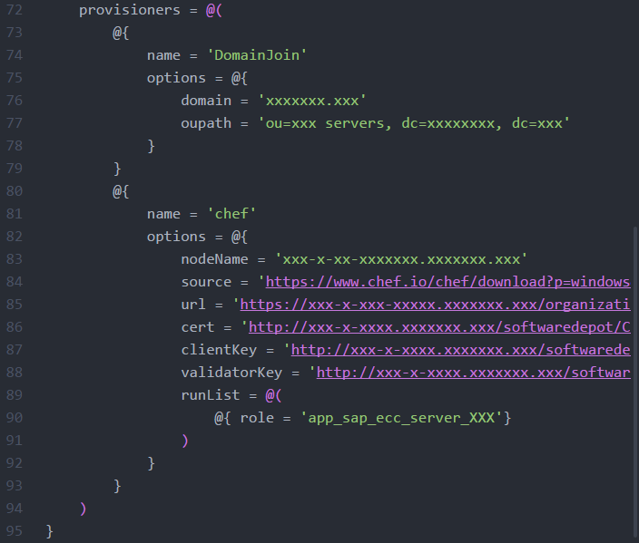
Bootstrapping CHEF on each new server
Notes:
We used PowerCLI & DSC to script bare metal Server provisioning
We’ve enhanced our template (optimized for WYSIWYG & reduced learning curve for Ops & Dev)
This pattern gives you great leverage to scale out
We are well over 250 nodes now, and we are now investigating brownfield applications and servers
We built on success by extending our server automation to a system refresh : 4 environments, 50+ greenfield servers, 3 tier COTS
Dev team worked to automate Tomcat, Ant, Java, Shares, etc.
Ops team worked to harden server automation

Slide 19
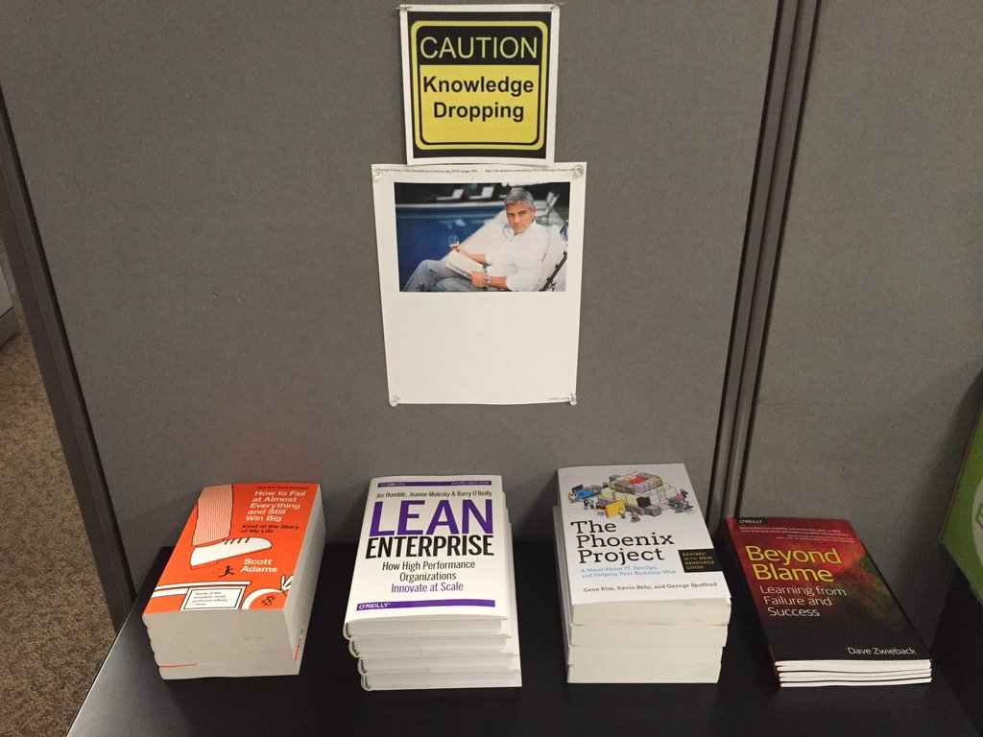
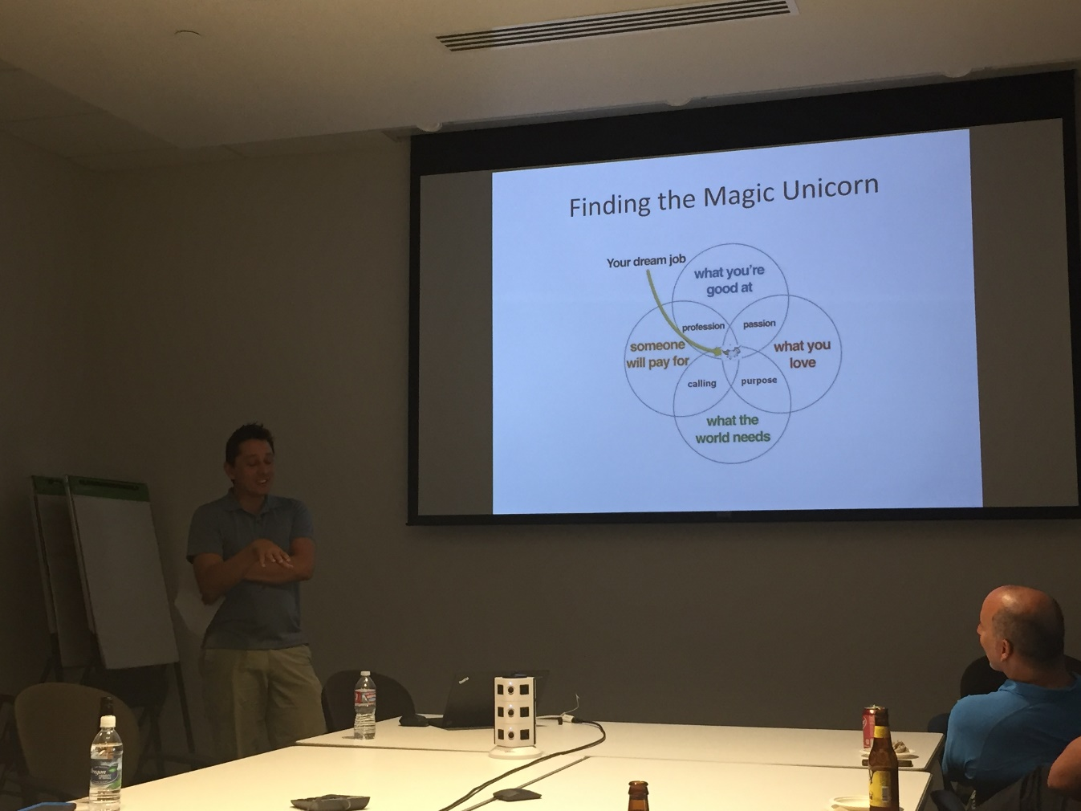
Building curious people
Notes:
Do engineers read? Not sure…We did put some books out to see what would happen (replenished a couple of times)
We’ve had 2 book clubs (facilitated by the team members) #1 – Beyond the Blame, #2 – How to Fail at Almost Everything and Still Win Big
We recently had a podcast club….My Year of Saying Yes, Surprising Habits of Creative People, How to Build a Better Job
We recognize that there are many distractions and we care less about how folks stay engaged

Slide 20
Thank You
Minimum Viable Process (apply PDCA!)
Find the win-win: good for the enterprise & good for team
Make it easy for new adopters to join
Scott Nasello @scottnasello | snasello@columbia.com

